Slide 1
Road Accident Severity

Slide 2
What is Accident Severity?
In general to understand any problem we need to know what it means. So therefore, firstly we will define what is Accident severity. Accident severity is the severity of accidents can be measured in terms of the number of fatal accidents or total economic loss due to accidents. Severe accidents not only lead to human loss of life but also heavy economic loss to the country.

Slide 3
Problem Description
Road accidents are a major world economic and social problem as shown by the report of loss of lives and properties in many countries around the world.Road accidents have been a major cause for concern across the Indian subcontinent.

Slide 4
In 2018 alone, the country reported around 151 thousand fatalities due to road accidents. Each year, about three to five percent of the country's GDP was invested in road accidents.
1214 road crashes occur every day in India. Two wheelers account for 25% of total road crash deaths. 20 children under the age of 14 die every day due to road crashes in in the country.

Slide 5
377 people die every day, equivalent to a jumbo jet crashing every day.In 2018, the Indian state with the highest number of road accidents was Tamil Nadu, with over 63 thousand cases reported, followed by Madhya Pradesh, with over 47 thousand reported road accidents in that year.

Slide 6
Here we have listed the five most dangerous roads in India that are scary for both two-wheelers and four-wheelers.
Leh Manali Highway. Leh Manali Highway
Rohtang Pass. Rohtang Pass
National Highway 22. National Highway 22
Zoji La Pass
Kinnaur Road

Slide 7
Background of the problem
The accidents can happened with below categoreis of vehicles:
Pedestrian/ 2 Wheeler/ 4 Wheeler and Heavy Vehicles
The accidents can be due to one of the below reasons :
Drink and drive Overloading Road Condition Unknown reasons Weather condition Traffic Driving skills

Slide 8
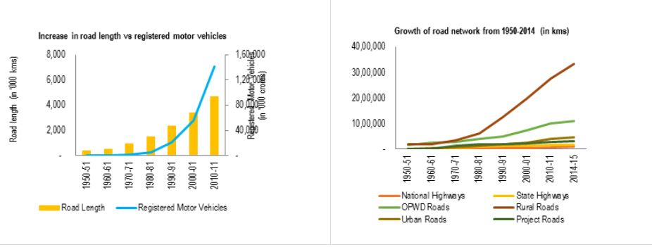
Road length has increased by 39%, number of motor vehicles have increased by 158%.

Slide 9
Problem solution
Our interventions on Road Safety include Engineering interventions like ihe identification of Black Spots on Roads and rectification of the same, working with the automobile Industry for putting in place safety provisions like seat belt reminder, air bags, speed alerts, reverse cameras, anti-lock braking systems, a strong advocacy policy etc.

Slide 10
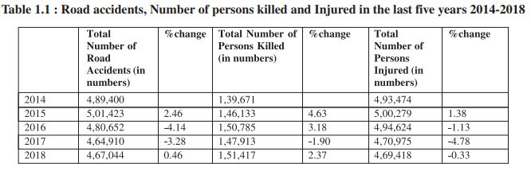

Slide 11
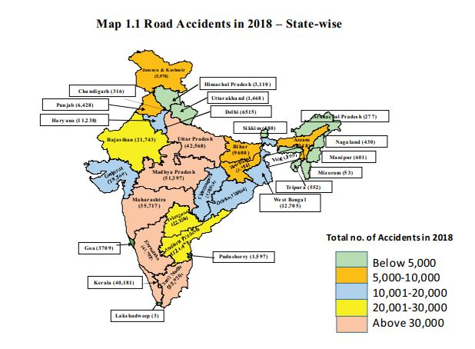

Slide 12
Result
Road accidents are multi-causal and are the result of an interplay of various factors. These can broadly be categorized into those relating to
(i) human error,
(ii) road environment and
(iii) vehicular condition.

Slide 13
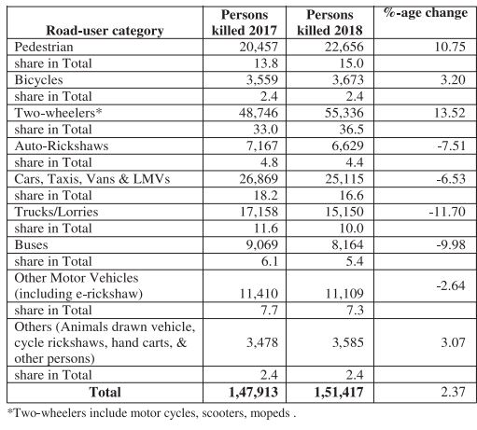

Slide 14
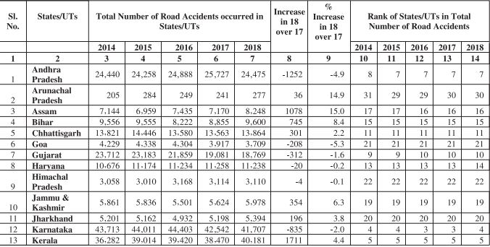
Performance of States/UTs during 2014 to 2018

Slide 15
Tamilnadu continues to retain the first rank in terms of accidents across States in 2018, like in 2017,despite a reduction in accidents of 1,642 by about 2.5%. The State accounts for about 13.7% of the total accidents in the country in 2018. Similarly, the State of Madhya Pradesh maintains its rank at second position in 2018 despite a reduction in accidents by 2,002. The States of Uttar Pradesh moved up in its ranking of accident from 4 in 2017 to 3 in 2018 registering an increase in accidents by 3,785 by 9.8%.

Slide 16
The State of Karnataka has also moved down in its ranking of accident from 3 in 2017 to 4 in 2018 registering a decline in accidents by 835 of about 2% over the previous year. The State of Kerala maintains its rank at position 5 in 2018 despite registering an increase in accidents in 2018 of 1,711 of about 4.4%.

Slide 17
Ways to avoid accidents
1.Pull into traffic slowly
2.Watch for red light runners.
3.Keep at least one hand on the steering wheel.
4.Watch for kids.
5.Perform engine maintenance regularly. Avoid sudden stalls or other vehicle failure by changing the oil regularly and keeping tires properly inflated.

Slide 18
6.Scan 12 seconds ahead.
7.Look backwards when backing out.
8.Don''t depend on mirrors alone
9.Do not tailgate.
10.Be courteous to other drivers. No one owns the roads, so treat others with respect and report any suspicious driving activity to authorities.

Slide 19
THANK YOU

